Slide 1
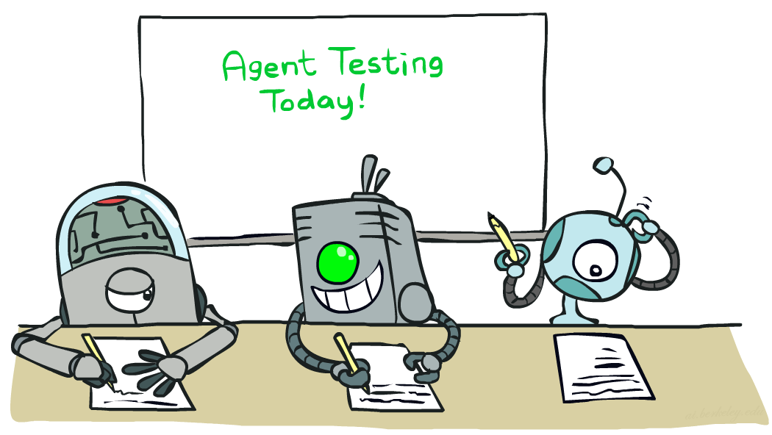
Machine Learning

Slide 2
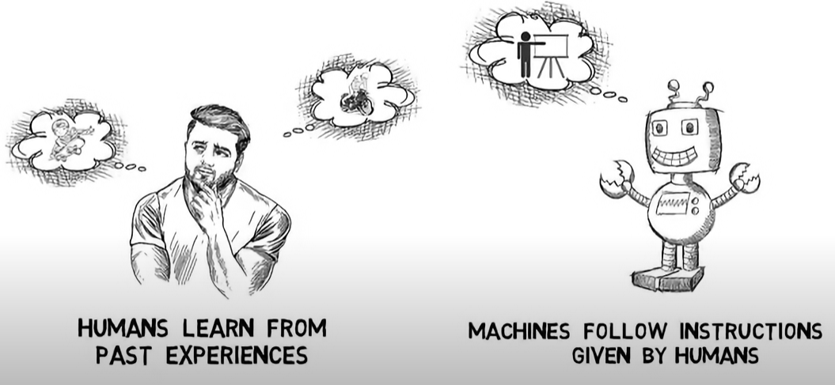

Slide 3
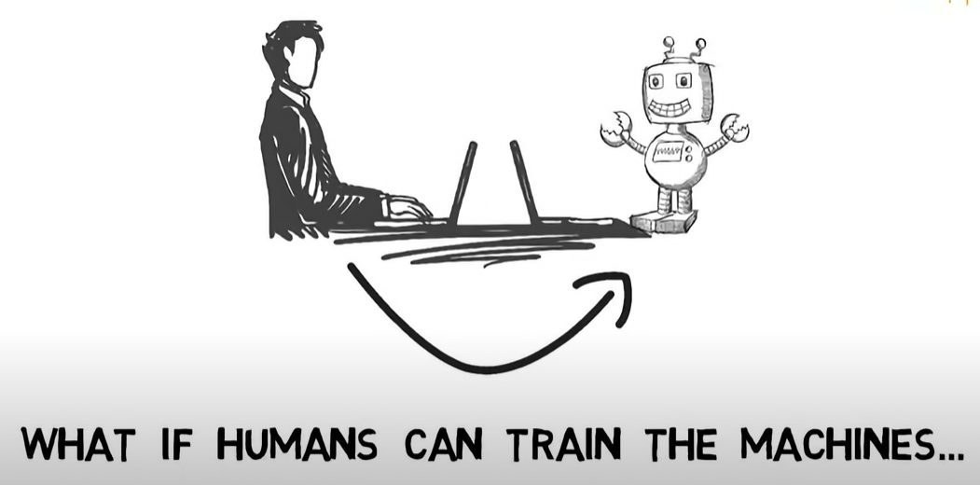
Learning
Understanding
Reasoning

Slide 4
Machine Learning
Up until now: how to use a model to make optimal decisions
Machine learning: how to acquire a model from data / experience
Learning parameters (e.g. probabilities)
Learning structure (e.g. BN graphs)
Learning hidden concepts (e.g. clustering, neural nets)

Slide 5
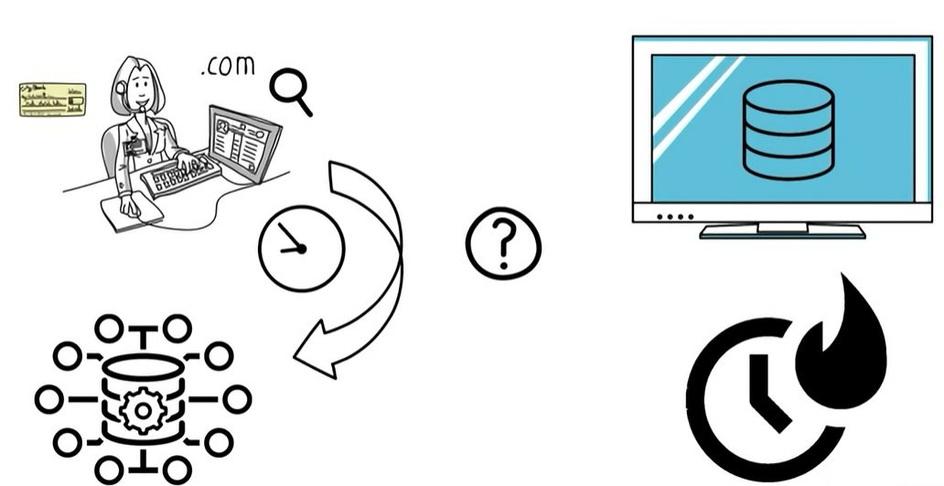
Why ML?

Slide 6
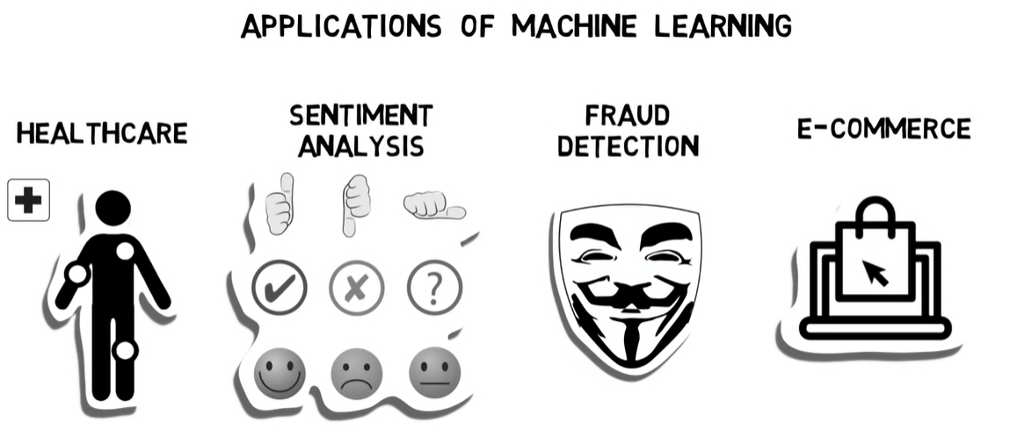

Slide 7
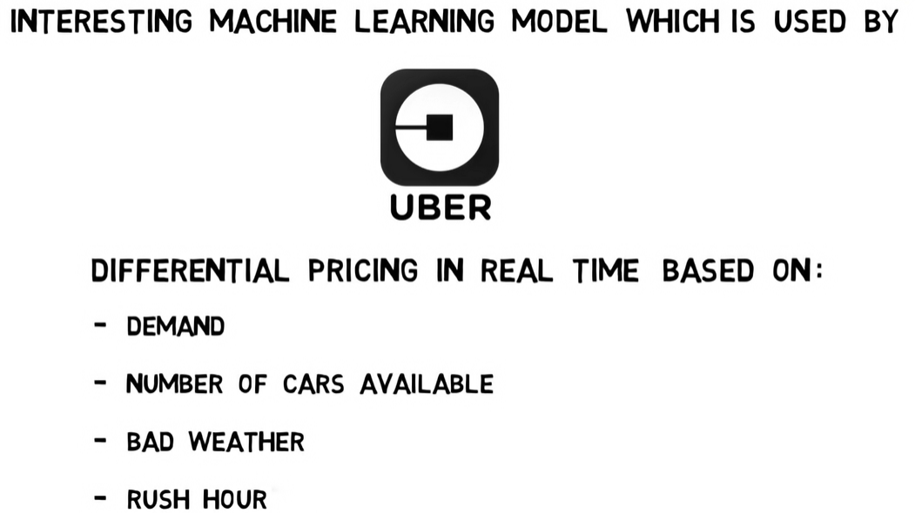

Slide 8
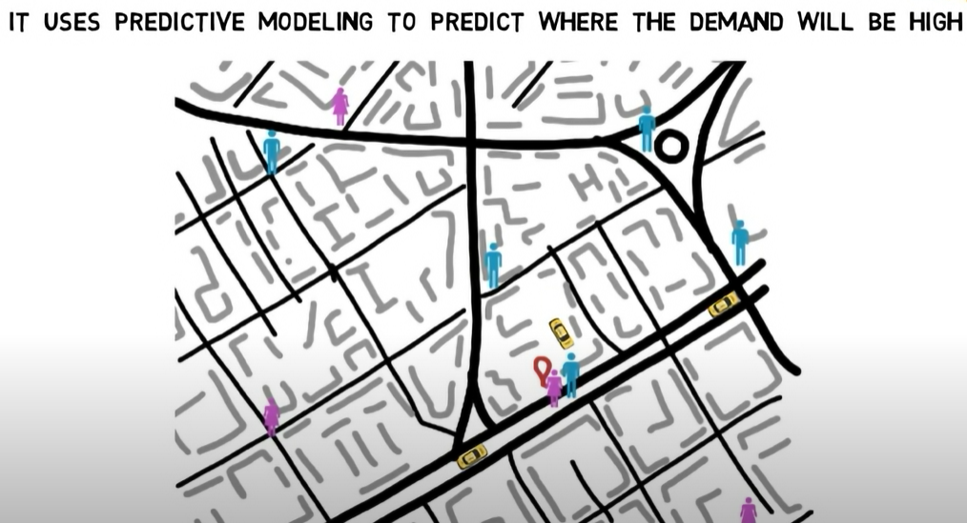

Slide 9
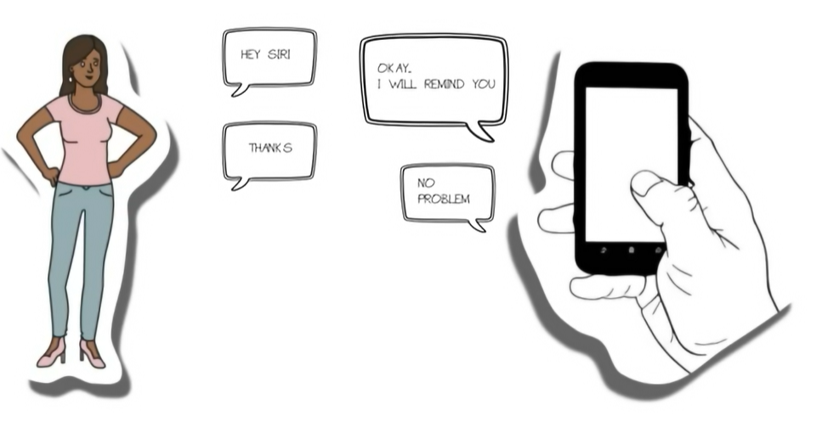
Chatbot SIRI

Slide 10
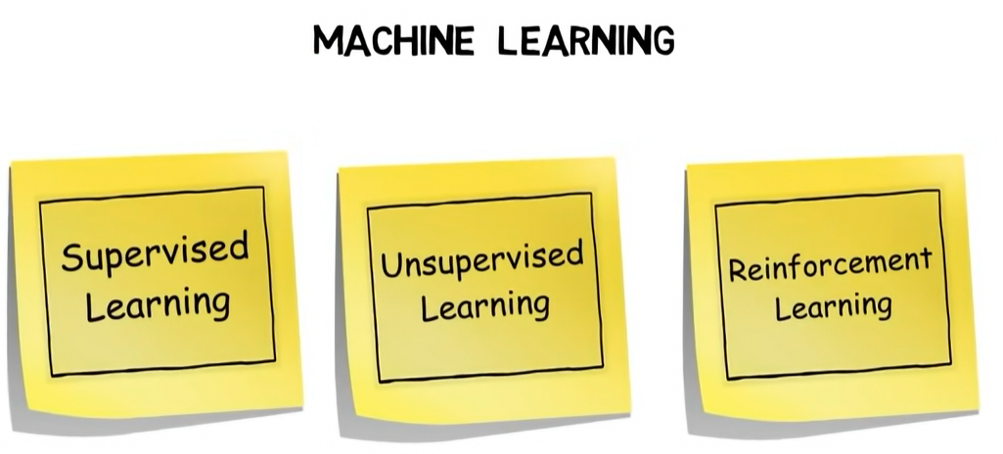

Slide 11
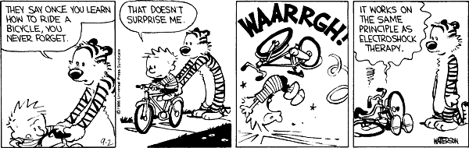
Categories of Learning
Learning by examples / Supervised learning
Learning by discovery / Unsupervised learning
Learning by experimentation / Reinforcement learning

Slide 12
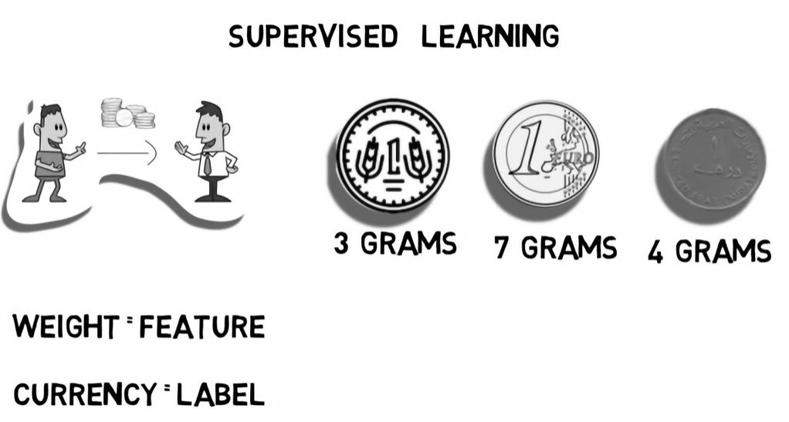

Slide 13
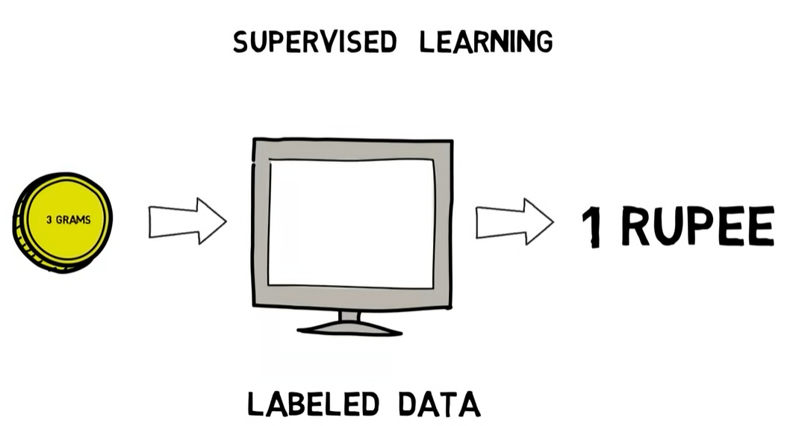

Slide 14
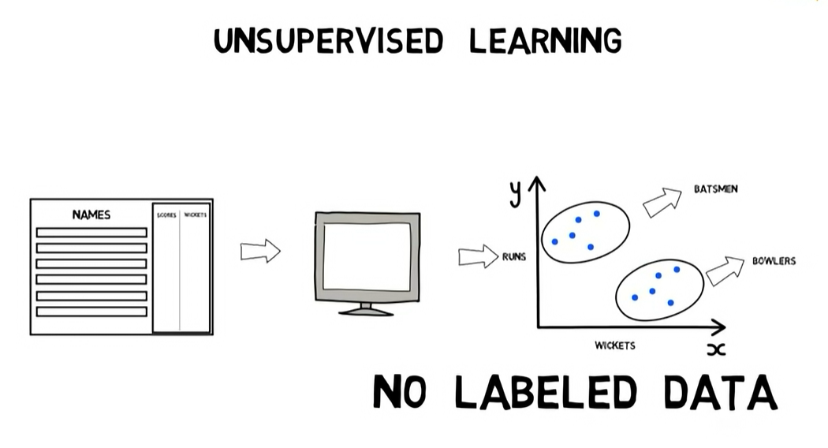

Slide 15
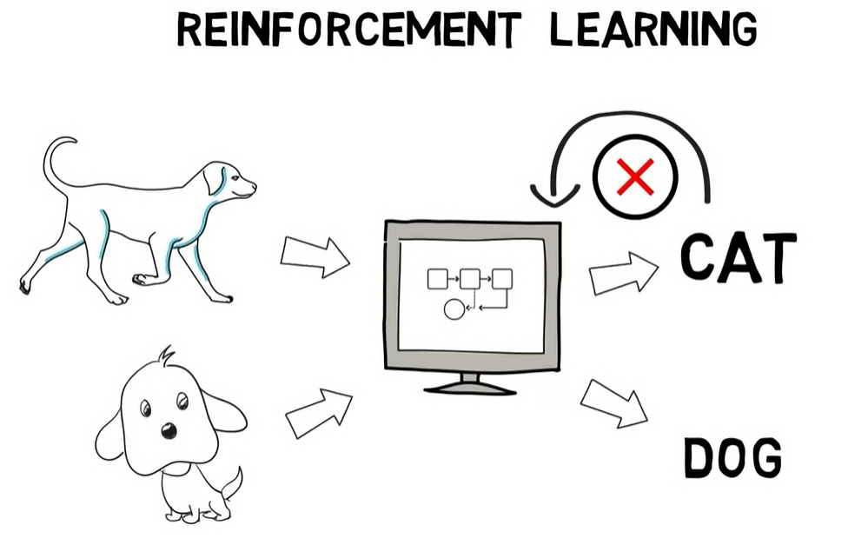

Slide 16
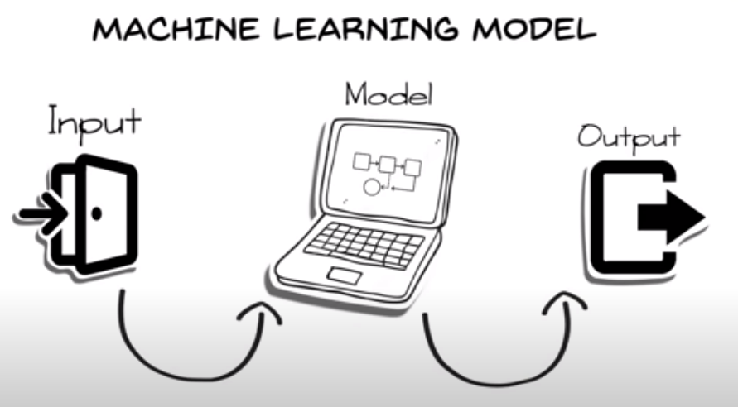

Slide 17
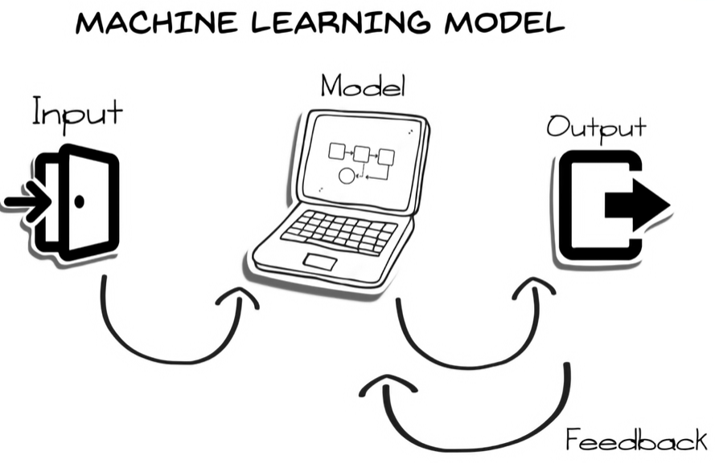

Slide 18
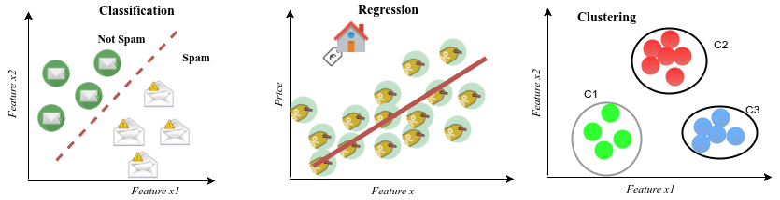

Slide 19
Learning From Examples
Learn general concepts or categories from examples
Learn a task (drive a vehicle, win a game of backgammon)
Examples of objects or tasks are gathered and stored in a database
Each example is described by a set of attributes or features
Each example used for training is classified with its correct label (chair, not chair, horse, not horse, 1 vs. 2 vs. 3, good move, bad move, etc.)
The machine learning program learns general concept description from these specific examples
The ML program should be applied to classify or perform tasks never before seen from learned concept

Slide 20
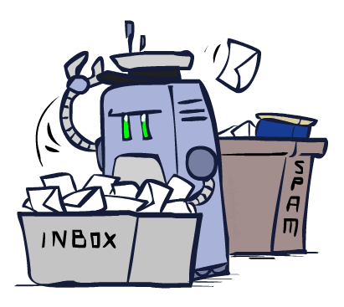
Classification

Slide 21
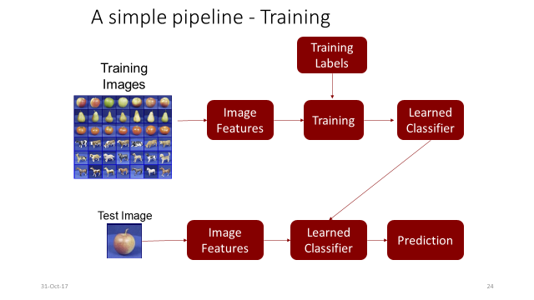

Slide 22
Example: Spam Filter
Input: an email
Output: spam/ham
Setup:
Get a large collection of example emails, each labeled “spam” or “ham”
Note: someone has to hand label all this data!
Want to learn to predict labels of new, future emails
Features: The attributes used to make the ham / spam decision
Words: FREE!
Text Patterns: $dd, CAPS
Non-text: SenderInContacts, WidelyBroadcast
…
Dear Sir.
First, I must solicit your confidence in this transaction, this is by virture of its nature as being utterly confidencial and top secret. …
TO BE REMOVED FROM FUTURE MAILINGS, SIMPLY REPLY TO THIS MESSAGE AND PUT "REMOVE" IN THE SUBJECT.
99 MILLION EMAIL ADDRESSES
FOR ONLY $99
Ok, Iknow this is blatantly OT but I'm beginning to go insane. Had an old Dell Dimension XPS sitting in the corner and decided to put it to use, I know it was working pre being stuck in the corner, but when I plugged it in, hit the power nothing happened.

Slide 23




Example: Digit Recognition
0
Input: images / pixel grids
Output: a digit 0-9
Setup:
Get a large collection of example images, each labeled with a digit
Note: someone has to hand label all this data!
Want to learn to predict labels of new, future digit images
Features: The attributes used to make the digit decision
Pixels: (6,8)=ON
Shape Patterns: NumComponents, AspectRatio, NumLoops
…
Features are increasingly induced rather than crafted
1
2
1
??

Slide 24
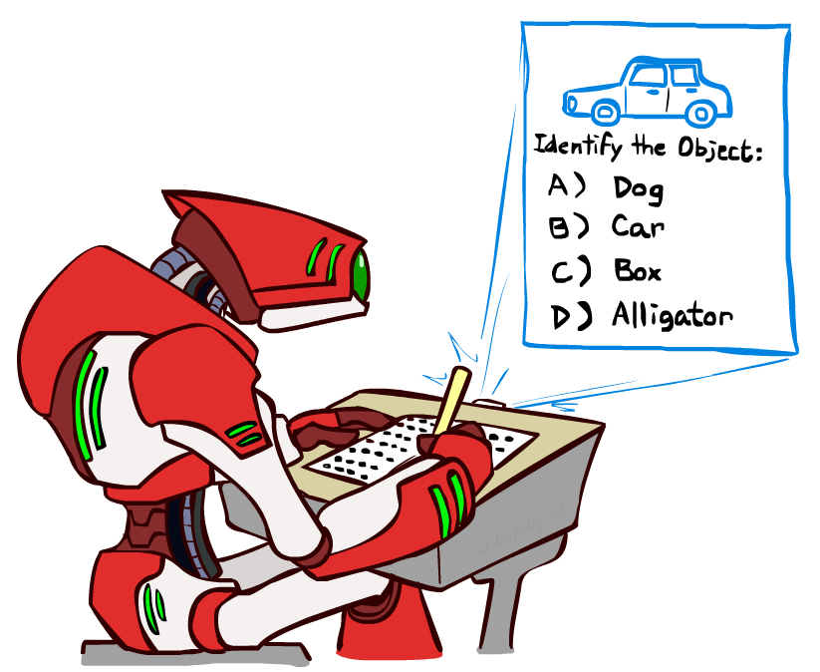
Other Classification Tasks
Classification: given inputs x, predict labels (classes) y
Examples:
Medical diagnosis (input: symptoms,
classes: diseases)
Fraud detection (input: account activity,
classes: fraud / no fraud)
Automatic essay grading (input: document,
classes: grades)
Customer service email routing
Review sentiment
Language ID
… many more
Classification is an important commercial technology!

Slide 25
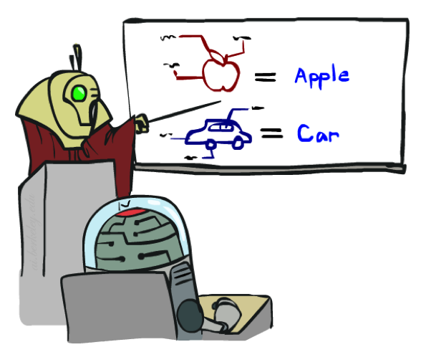

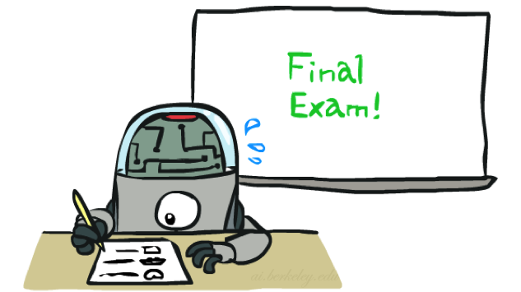
Training and Testing

Slide 26
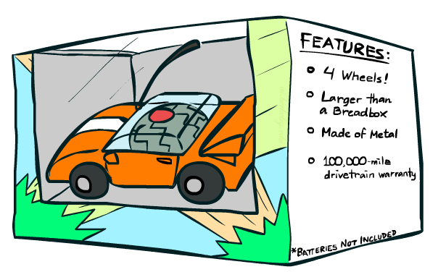
Features

Slide 27
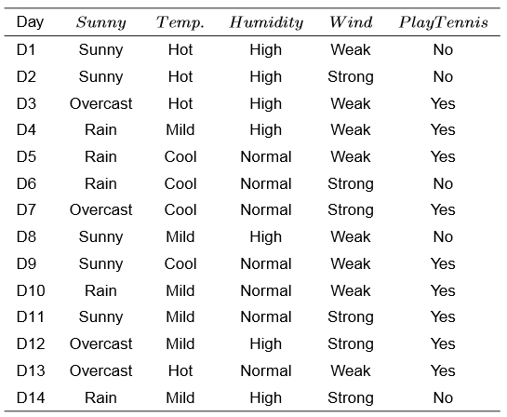
Illustrative Example
Target Label Y
Feature vector

Slide 28
Another example
Target Label Y
Features
Size (feet²) x1 | Number of bedrooms x2 | Number of floors x3 | Age of home (years) x4 | Price ($1000)
2104 | 5 | 1 | 45 | 460
1416 | 3 | 2 | 40 | 232
1534 | 3 | 2 | 30 | 315
852 | 2 | 1 | 36 | 178
… | … | … | … | …

Slide 29
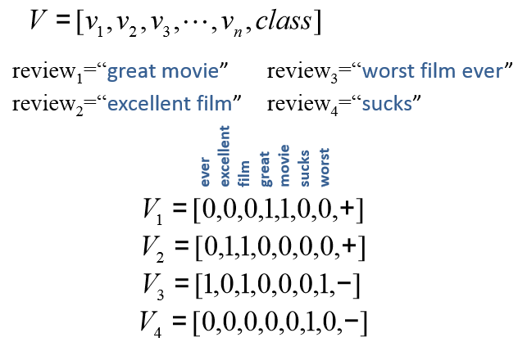
Movie review data example From text to vectors
Features
Target Label Y

Slide 30
Summary : Types of learning
Supervised learning: learn mapping from attributes to “target”
Classification: target variable is discrete (e.g., spam email)
Regression: target variable is real-valued (e.g., stock market)
Unsupervised learning: no target variable; “understand” data structure
Clustering: grouping data into K groups
Reinforcement learning: e.g., game-playing agent
the agent does not know the exact output for an input, but it receives feedback on the desirability of its behavior
the feedback can come from an outside entity, the environment, or the agent itself
the feedback may be delayed, and not follow the respective action immediately

Slide 31
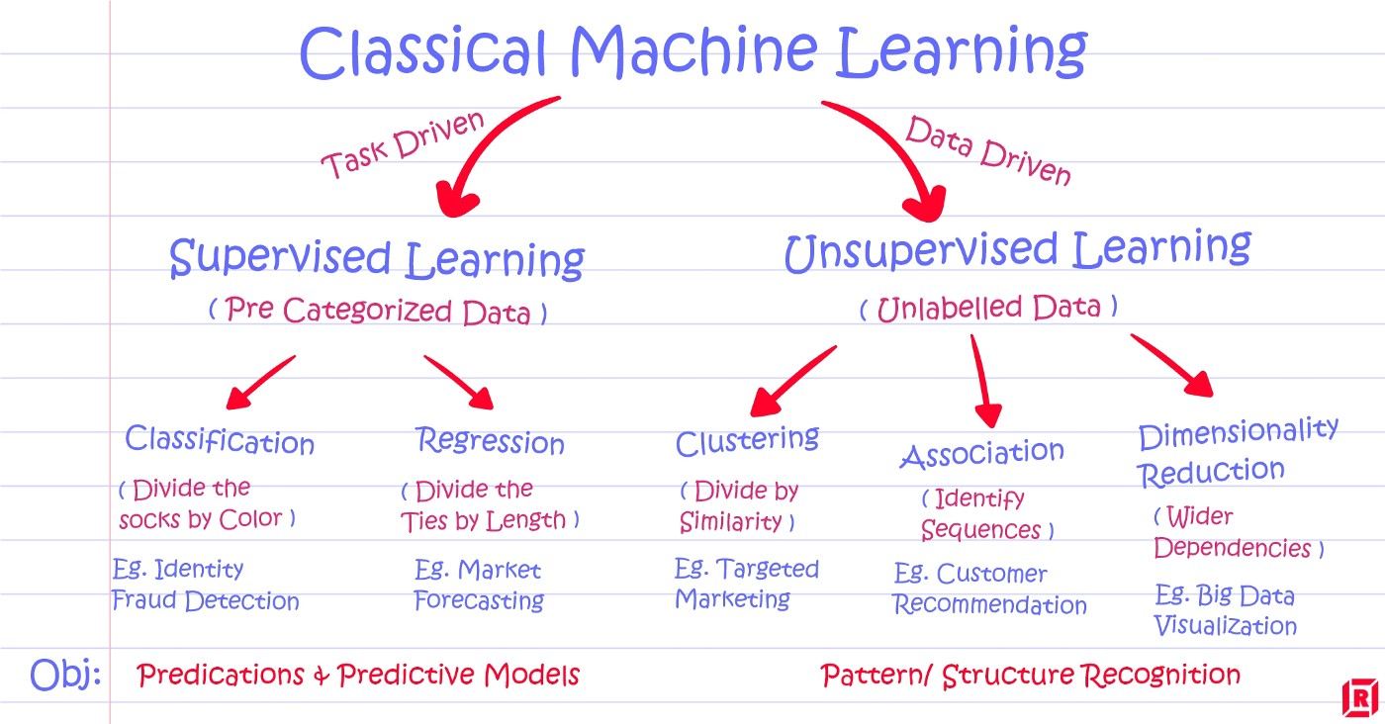

Slide 32
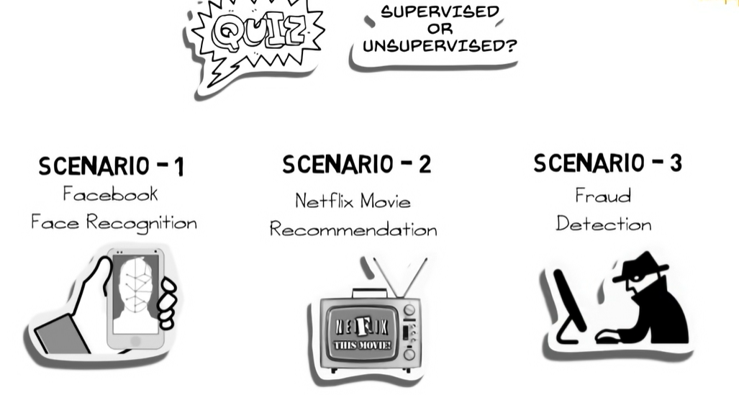

Slide 33
Thank you

